Slide 1
On Roots of Social Difference
Section One

Slide 2
Big idea: What causes inequality?
We live in a world characterized by vast inequalities, both among places and within them. Why do some people have seemingly limitless access to wealth and resources while others live in impoverished conditions and struggle to survive? Is it due to innate personal characteristics? To cultural or racial traits? To structural inequities? And how might different explanations for inequality serve different interests? This week, we tackle early anthropological theories about human sameness, difference, and inequality.

Slide 3
Learning Objectives
By the end of this week, students will be able to:
Articulate different explanations for social inequality and critically evaluate their merits and limitations
Identify key figures in these discussions and consider how their social and scholarly positions interact
Explain the difference between material and idealist worldviews

Slide 4
On roots of social difference

Slide 5
The social context

Slide 6
19th and 20th Century
Social Context:
Colonialism
Slavery & Civil War
Mass European Emigration
Women’s suffrage movement
Pogroms in Europe
Key Questions:
Are people all related? And if so, how?
Who deserves rights? Land? Resources? Power?
Cecil Rhodes

Slide 7
The intellectual foundation

Slide 8
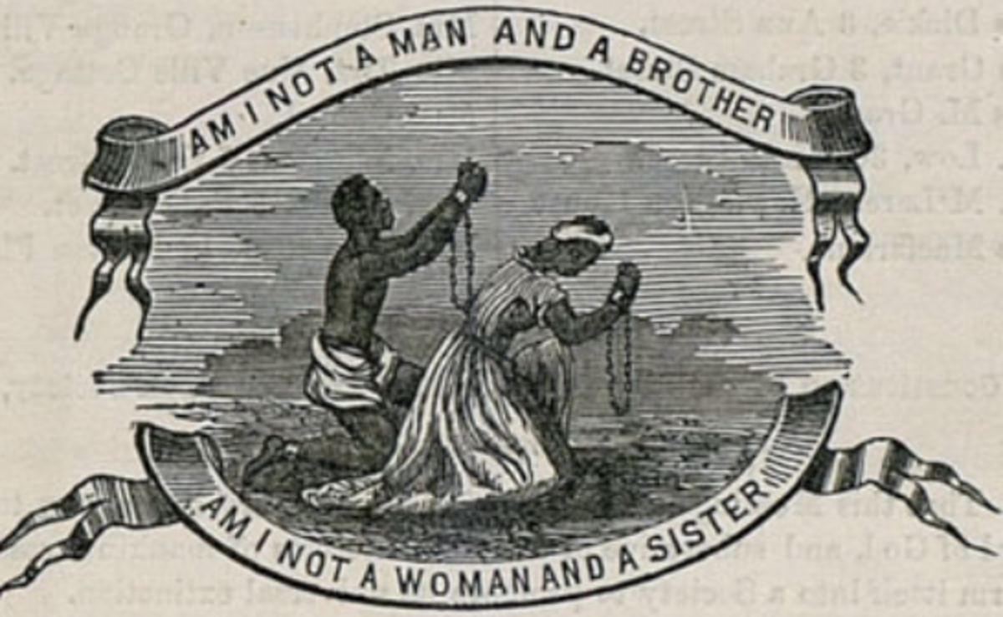
19th and 20th Century Social Theory
Evolution
Classification of living organisms
Evolutionary theory
Political economy
Abolition
Women’s suffrage
Nationalism
Anarchy
Capitalism
Socialism
Communism

Slide 9
Guiding questions

Slide 10
Guiding Questions
What best explains the differences, and profound inequalities, among human groups? What about their similarities?
Are socioeconomic and political inequalities natural and inevitable? Are colonialism, slavery, and women’s subjugation justifiable? How can we change society to be more equitable?

Slide 11
The Essays

Slide 12
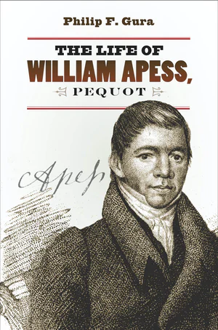
Anti-Colonialism
Key Figure
Key Text
William Apess
The Indian’s Looking Glass for the White Man (1833)
Indian Removal Act (1830)
Homestead Acts 1860 and later

Slide 13
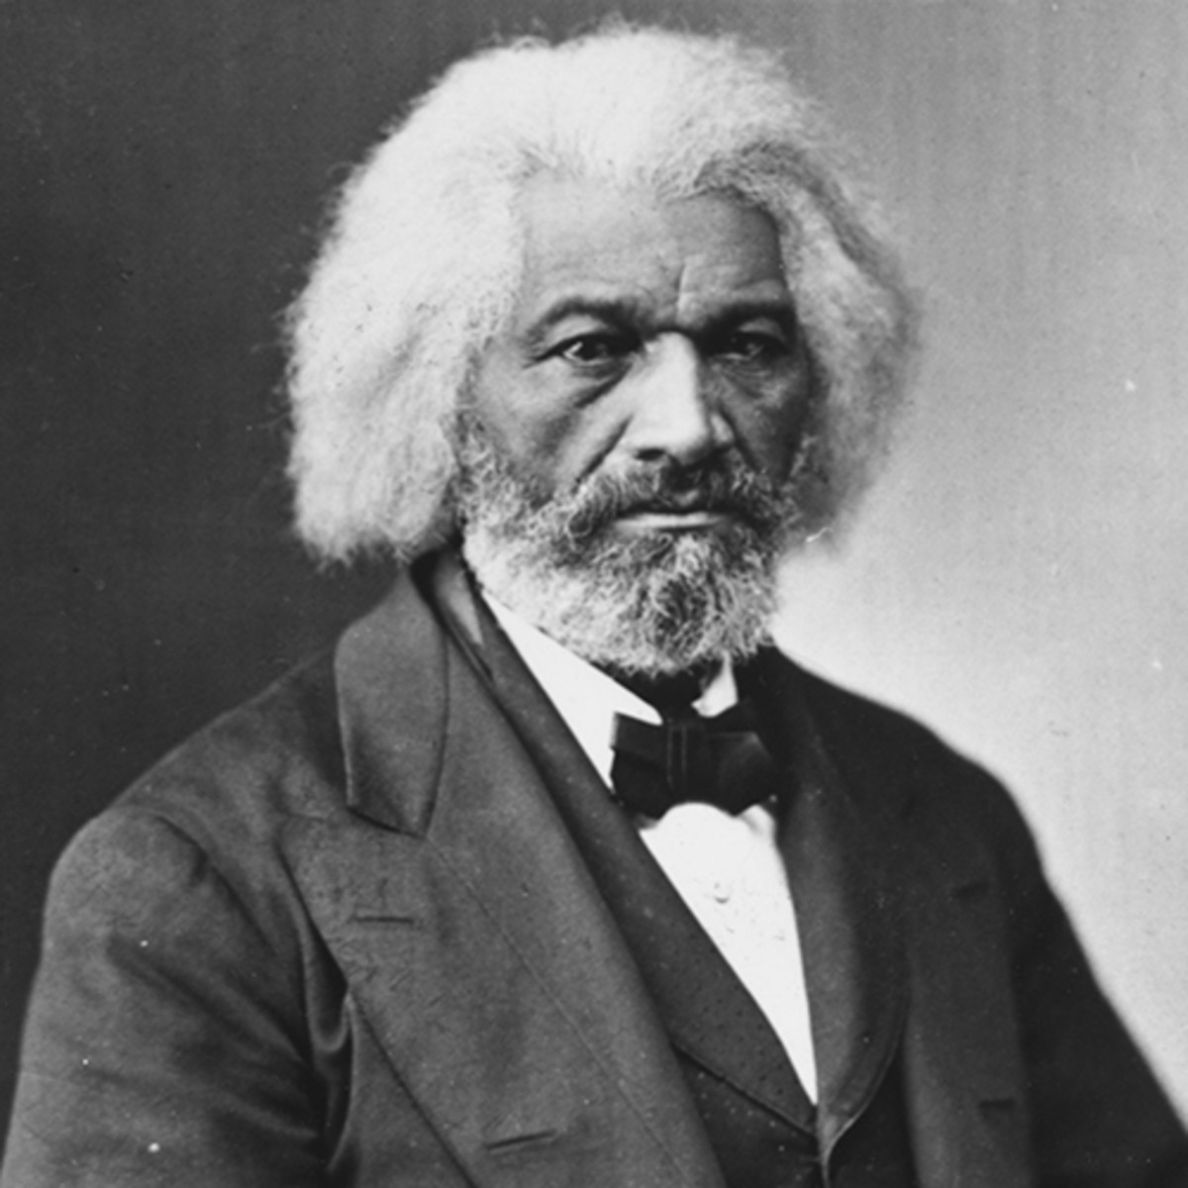
Abolitionism
Key Figure
Key Text
Frederick Douglass
Claims of the Negro, Ethnologically Considered (1854)
Dred Scott decision (1857)
US Civil War (1961-1865)

Slide 14
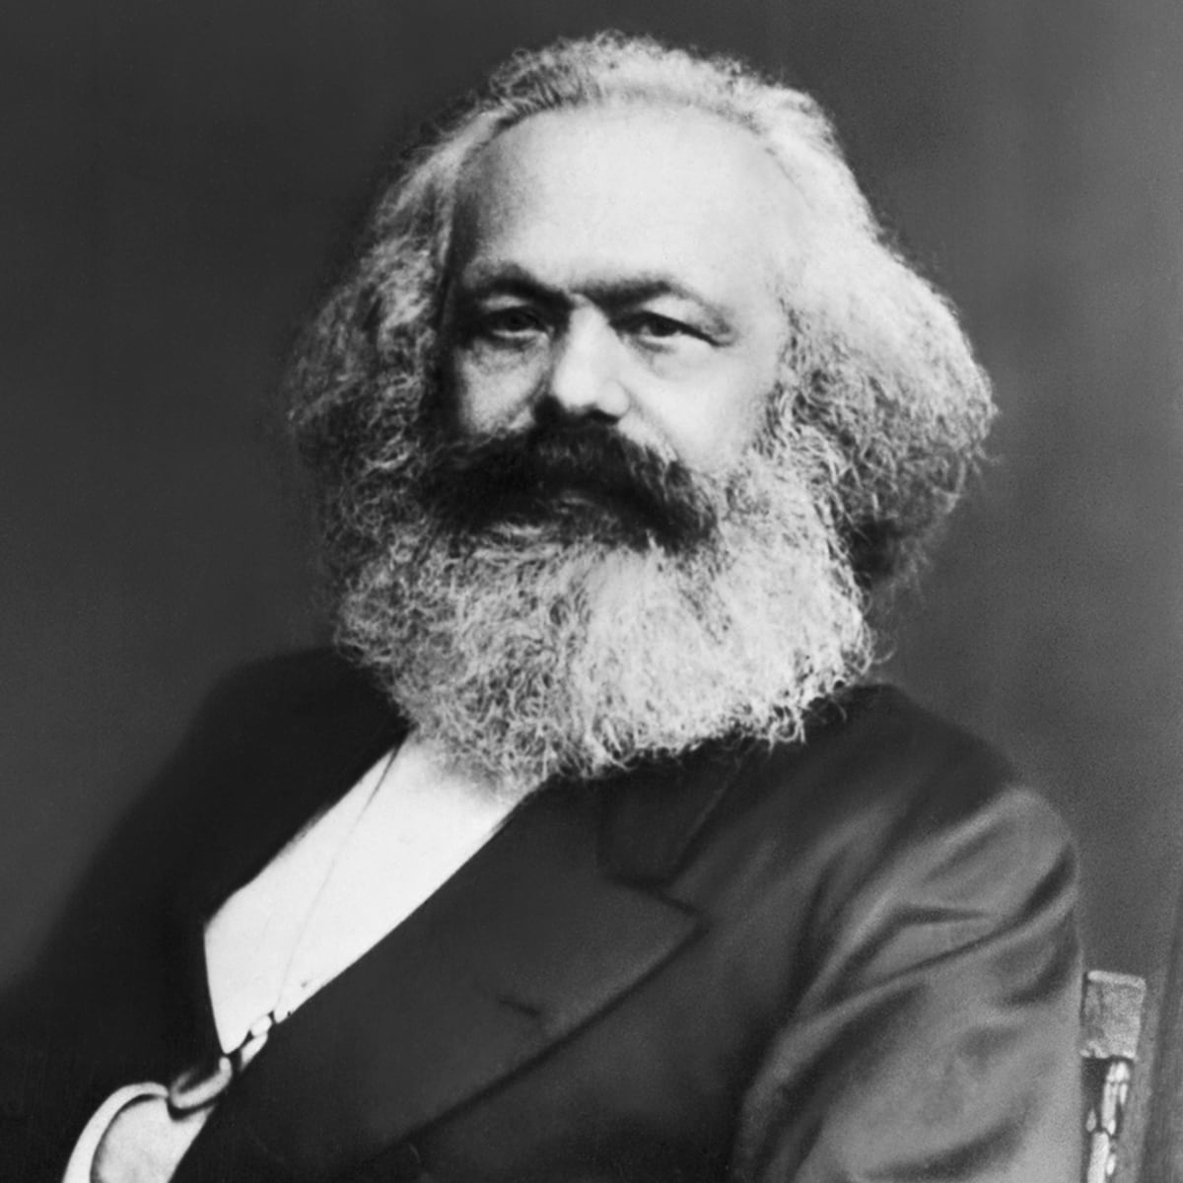
Anarchy, Socialism, Communism
Key Figures
Key Text
Marx & Engels
Labor groups
The Communist Manifesto (1872)
WWI 1914-1918
Russian Revolution 1917

Slide 15
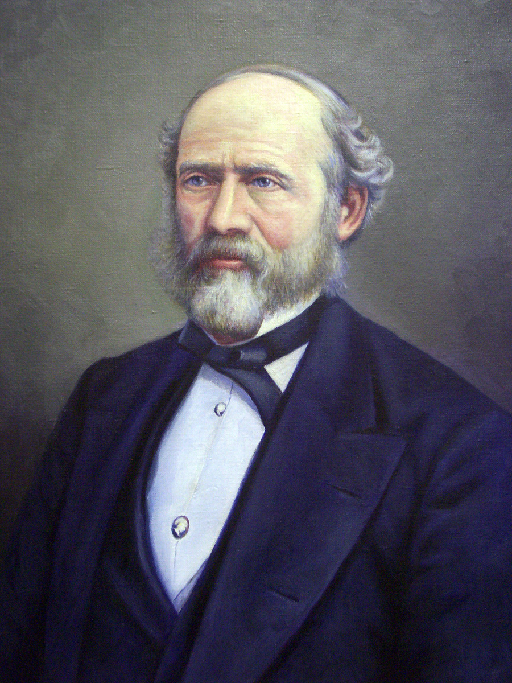
Sociocultural Evolution
Key Figures
Key Text
Bureau of American Ethnology
Powell, Brinton, Morton
Herbert Spencer
E.B. Tylor
Lewis Henry Morgan
Ancient Societies (1877)

Slide 16
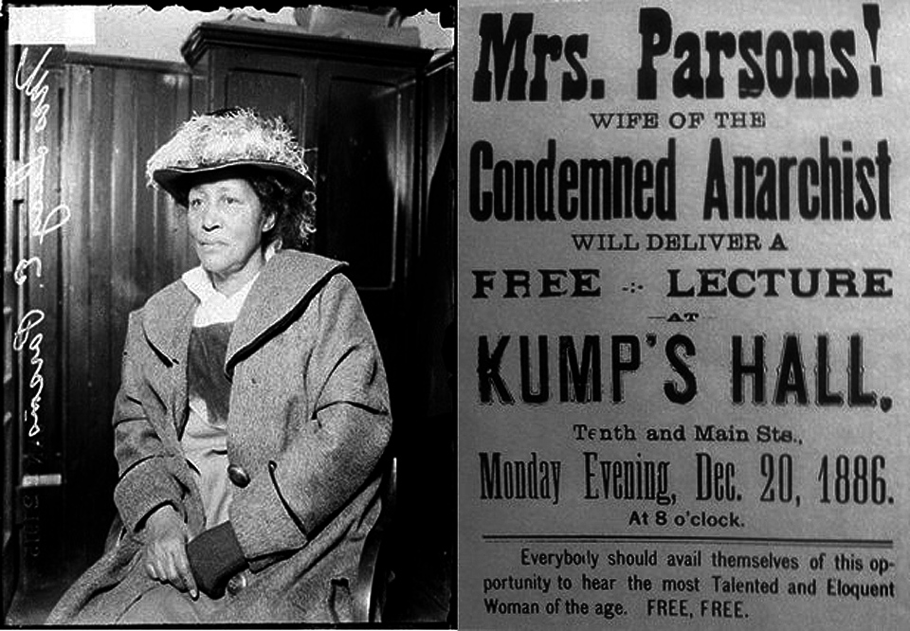
Women’s Rights & Labor Rights
Key Figures
Key Text
Lucy Parsons: “more dangerous than a thousand rioters”
Founding Convention of the IWW (1905)
May Day massacre (1886)
Triangle Shirtwaist strike (1909)
Women’s suffrage (1920)

Slide 17
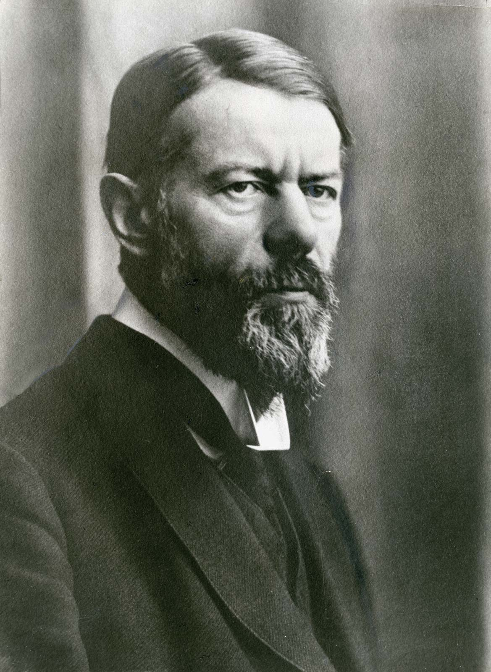
Capitalism
Key Figures
Key Text
Adam Smith
Max Weber
The Spirit of Capitalism (1930)

Slide 18
The takeaways

Slide 19
Key Takeaways
Materialism & Idealism
What is primary?
How can they be reconciled?
How does social inequality shape theories of human sameness and difference?

