Slide 1
On Environment
Section 11

Slide 2
Big idea: on human ecologies
As devastating effects of climate change are ubiquitously yet unevenly felt across the world, anthropological insights into human interactions with environments, or human ecologies, are increasingly important. The readings in this section span several decades and illustrate the conceptual development of environmental anthropology over time.

Slide 3
Learning objectives
Demonstrate familiarity with concepts including cultural ecology, ontology, and pluriverse
Explain the role of political economy in shaping human treatment of non-human elements of the world
Describe how indigenizing perspectives shift the centrality of people in environmental conceptualizations

Slide 4
Environmental Anthropology
Key Ideas
The environment affects culture
And vice versa
Eurocentric culture overemphasizes the importance of humans in relation to other elements of the natural world
Capitalist exploitation of natural resources
Marx and utilitarian usage of natural resources
The ontological turn:
Nature v culture? No, nature is a cultural concept
Not only worldviews, but worlds vary
There is no universal reality

Slide 5
Environmental Anthropology
Key Terms
The Anthropocene
Cultural ecology
Political ecology
Pluriverse
Ontology
Eco-fascism

Slide 6
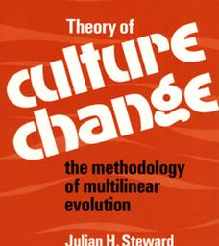
Julian Steward
Cultural Ecology: how do humans adapt to their environments?
Multilinear Evolution
Analytical Framework:
Technology & environment
Behavior
Cultural adaptation

Slide 7
Paige West
Political Ecology
Understanding socioecological interactions in their broader (political, economic, ideological) contexts
Gimi: Existence via mutual recognition amongst human and non-human beings
There is no “nature” apart from that system

Slide 8
Zoë Todd
“Indigenizing the Anthropocene”
“Anthropocene” as analytic:
Too human-focused
Doesn’t distinguish between the people and nations that drive fossil-fuel industry and those that don’t
“Métissage” ideology that connects beings across time

Slide 9
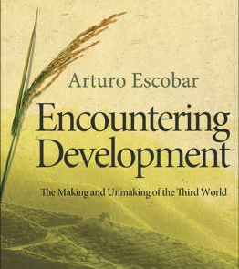
Arturo Escobar
Relationality
Pluriverse: multiple and overlapping conceptual universes
Partial and assymetrical relations
Translation

Slide 10
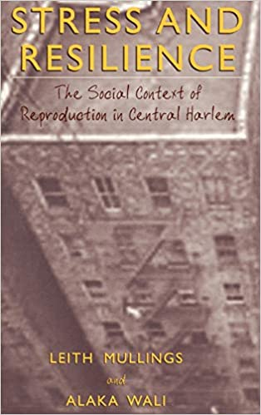
Alaka Wali
Anthropology in action: supporting the “economía indígena” in the Amazon
Pluriverse
Making the community the experts
Making the “experts” the students

Slide 11
Key takeaways
Human-centric theories of environment developed in a context of colonialism/global capitalism prioritizing extraction and exploitation rather than relationship
Other ideological worlds not comprehensible through those (Western) frames, and vice versa

