Slide 1
On State power
Section 12

Slide 2
Big Idea
State societies are highly unequal by definition, and they are also typically unstable (consider that most nation-states don't last more than a few centuries). How, then, do nation-state leaders mobilize state apparatuses (military, police, governance institutions) to maintain power and hegemony? This section examines the role of legalized violence in maintaining state power. In particular, the scholars in this section consider how categorical inequalities are maintained through force.

Slide 3
Learning objectives
Identify forms of state-sponsored violence
1
Articulate how state violence upholds state power
2
Explain why state violence especially targets racialized communities
3

Slide 4
The Essays

Slide 5
Anthropology of the State
Key Ideas
Politics: who makes decisions and exercises control?
Power: the ability to force others to do what you want
Features of state society
Monopoly on the legitimate use of violence (Weber)
Bureaucracy, legal system, prisons, military, hierarchy

Slide 6
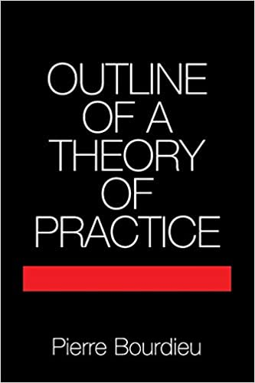
Pierre Bourdieu
The left and right hands of the state
Symbolic systems: power to create reality
Origin myths
Expressions of nationalism
Symbolic violence: reinforces domination of ruling class
Grading/schooling
Legality/illegality

Slide 7
Begoña Aretxaga
What the border reveals
Colonial domination
Spectacle of state control
Assert ethnonational difference
Nationhood as gendered, classed

Slide 8
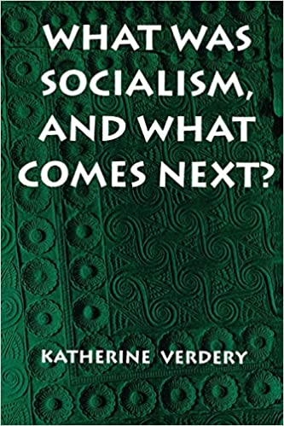
Katherine Verdery
Seeing Like a State (Scott)
Seeing Like a Mayor
“The state” not a monolith
Enacted by people
Local differences

Slide 9
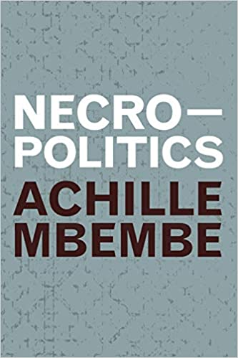
Achille Mbembé
States of Exception (Agamben)
Necropolitics
The state: the power to decide who lives and who dies
Sovereignty: the right to kill
Police killings (Black lives/all lives)
Military invasion v terrorist attack

Slide 10
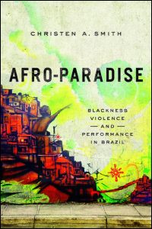
Christen Smith
Death squad murders
Context: globalized racism and exportation of techniques of torture and murder
Enforce anti-Black violence
Not extra-legal, but legal
“Not a state of exception, but the state of affairs”

Slide 11
Key takeaways
The state, like everything else, a cultural construction that is contingent, contested, and both powerful and vulnerable
State force a mechanism for upholding state structures, especially inequality

