Slide 1
On Agency and Social Struggle
Section 13

Slide 2
Big Idea: Agency and Struggle
Highly unequal and repressive exercises of state violence beget myriad forms of community resistance. The essays in this section explore the ways in which people carve out autonomy, well-being, and organizing power to contest and transform their vulnerabilities. Far from treating marginalized people as mere victims, these pieces demonstrate how everyday agency shapes the world in big and small ways.

Slide 3
Learning Objectives
Conceptualize
human agency, resistance, and refusal
Theorize
complex relationships among state actors, non-state actors, and communities in struggle

Slide 4
The Essays

Slide 5
Agency and Social Struggle
Key Ideas
Human agency
And structure
And resistance?
Collective agency
Social struggle
Refusal (Simpson)

Slide 6
Saba Mahmood
Women’s Islamist movement
Why would people participate in movements that call for their subjugation?
Women for Trump
Agency as resistance?
No, agency can be normative and conservative

Slide 7
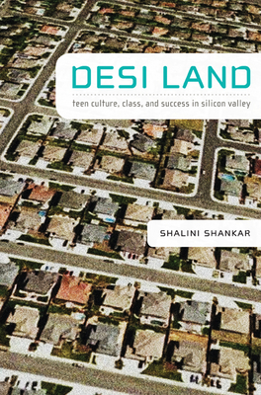
Shalini Shankar
Linguistic anthropologist
Speaking Like a Model Minority
FOB by teens in CA marked by
Immigration
Ethnicity
Class
Gender
How do they respond?
Linguistic play

Slide 8
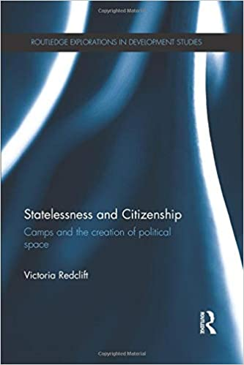
Victoria Redclift
Abjects or agents?
Abjection & “bare life”
Wash U conference
Why can’t detained people have agency?
The camp itself as a political space
Agency of disempowered people

Slide 9
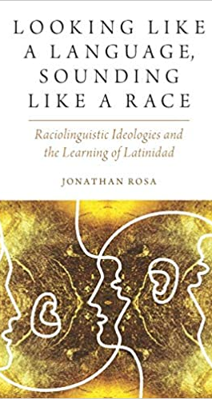
Yarimar Bonilla and Jonathan Rosa
Murder of Michael Brown Ferguson, MO
The official state discourse
The unofficial social media discourse
“Democratizing” sociopolitical narratives
Hashtag ethnography

Slide 10
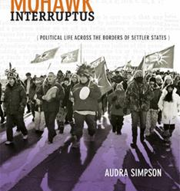
Audra Simpson
Ethnographic refusal
Political refusal
Why be complicit in your own subordination?

Slide 11
Key Takeaways
State power is never absolute but always contested
Agency is the capacity to exert one’s will and is differentially empowered or constrained by structure, even as human agency creates and maintains social structures
Sometimes collective agency against the state manifests as social struggle

