Slide 1
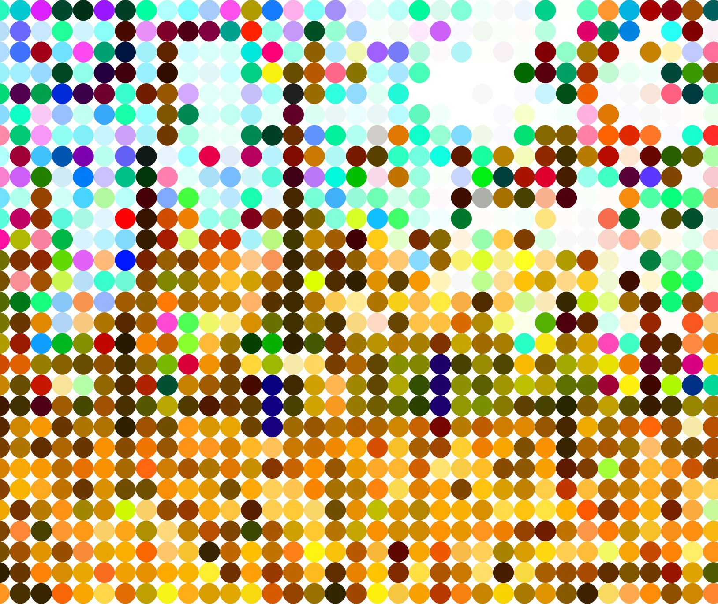
On Hidden Cultural Logics
section 3

Slide 2
Big idea: what causes cultural patterns?
Some cultural patterns seem too common or complicated to be explained by historical particularism, diffusion, or coincidence. Is it possible that humans have a "psychic unity" that tends to produce similar cultural patterns across different groups? Things like adaptive behavioral norms, dichotomous thinking, gift exchanges, origin stories, and morality? This week, we explore theories of hidden cultural logics: invisible yet prevalent human tendencies that drive cultural patterns.

Slide 3
Learning objectives
By the end of this week, students will be able to:
Identify key figures and theories in these genres
Explain insights and limitations of these theoretical paradigms

Slide 4
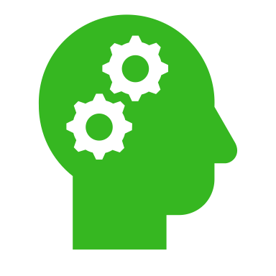
On hidden cultural logics

Slide 5
The social context

Slide 6
The essays

Slide 7
functionalism
Key Idea
Key Text
Culture functions to address basic human needs
Psychological functionalism
Structural functionalism
Argonauts of the Western Pacific (Malinowski)
People incapable of perceiving broader social function of their activities
Emic/etic; going native
Kula Exchange
What is it?
Functions: create allyships (safety); facilitates secondary exchange (nutrition); promotes socioemotional wellbeing

Slide 8
Malinowski
War exile
Fieldwork expert
Diary in the Strict Sense of the Term

Slide 9
Culture and personality
Key Ideas
Key Texts
Culture, not biology, determines individual and societal traits
Patterns of Culture (Benedict)
“The purpose of anthropology is to make the world safe for human differences”
Coming of Age in Samoa (Mead)

Slide 10
Patterns of culture
“No man ever looks at the world with pristine eyes. He sees it edited by a definite set of customs and institutions and ways of thinking.” (read: culture)
“We do not see the lens through which we look”

Slide 11
The gift - marcel mauss
Gifting is a social norm that establishes and maintains social relationships
Obligations of gifting, receiving, and repaying
Reciprocity
Generosity → Status and prestige
“Bragging money”
The “function” of gifting

Slide 12
Andy and Dwight gift each other favors

Slide 13
French Structuralism
Key Idea:
Key Figure:
Culture a product of the mind
Universal structures of human thought
Binary contrasts
Similar thought structures -> similar cultural traits
Kinship, myths, religion in “indigenous” (read: non-Western) societies
Claude Levi-Strauss
Best bud of Boas

Slide 14
Language and the analysis of social laws
Language
Divisible into (unconscious) phonemes and grammatical laws
What about other social behaviors?
Marriage and residency patterns
Myths and folklore
Art
Religion

Slide 15
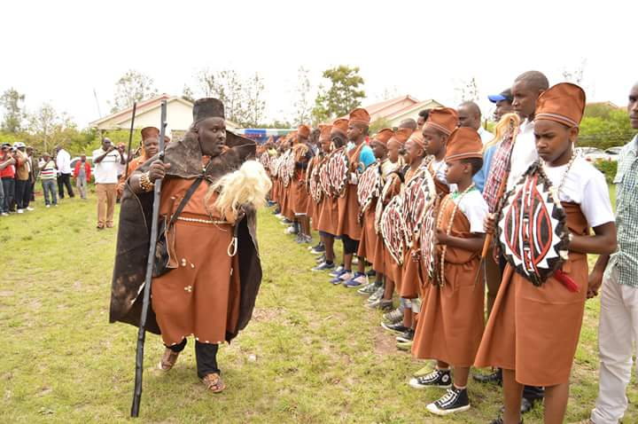
Functionalism meets anti-colonialism meets native ethnography
Key Text:
Key Figure
Facing Mt. Kenya
The Gikuyu people
Colonial context
Gikuyu representations of fairness and ethics
Morality through storytelling
Jomo Kenyatta

Slide 16
Key takeaways
Culture more than a random assemblage of shared behaviors
Cultural patterns rooted in human biological or social needs or in our physiology

