Slide 1
On Writing Cultures
Section 5

Slide 2
Big Idea: On writing cultures
As some anthropologists began attending carefully to issues of power and history, others embarked on anthropological approaches that centered on personal, embedded, and phenomenological experiences in the field. By the latter half of the 20th century, postmodernism, an artistic and academic pursuit that challenged universalizing and positivist discourses associated with modernism, had become an important and controversial strain of anthropological research. In particular, theorists in this section call attention to partiality and subjectivity in research endeavors and to ethnographic writing as art instead of science.

Slide 3
Learning Objectives
By the end of this week, students will be able to:
Identify major characteristics of postmodern anthropology
Describe how attention to researcher experiences shapes anthropological writing
Explain an array of approaches to fieldwork that include audible, visual, and embodied forms of knowledge

Slide 4
The Social Context

Slide 5
The Essays

Slide 6
Twenty-Seventh Day
Katherine Dunham: the “Matriarch of Black Dance”
Pioneer of African American dance
Student of Sapir and Malinowski
Caribbean and African rhythms; “black dance” as an art form
Activist
Embodied Knowledge
What is knowable that is not otherwise accessible?
The Dunham Lab Dance Technique

Slide 7
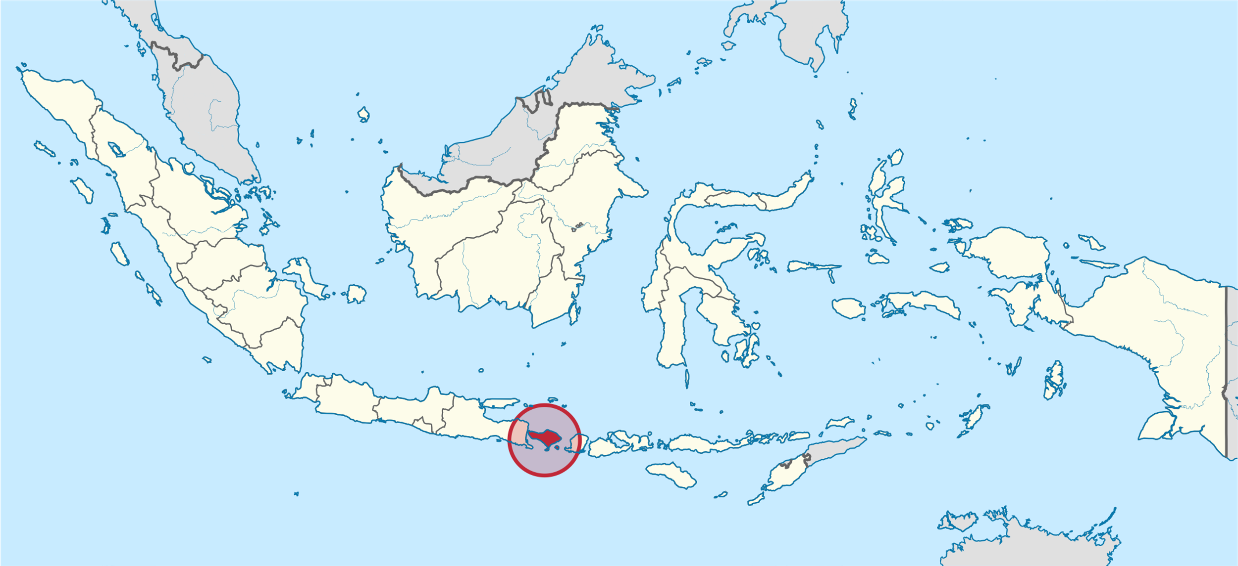
The Balinese Cockfight
Clifford Geertz: Influenced by Weber
Bali, Java, Indonesia
“Thick description”
Winks and blinks
The onion is its layers, as culture is its meanings
Cockfighting as symbolic of masculinity
Cockfight participants play with status through the fights

Slide 8
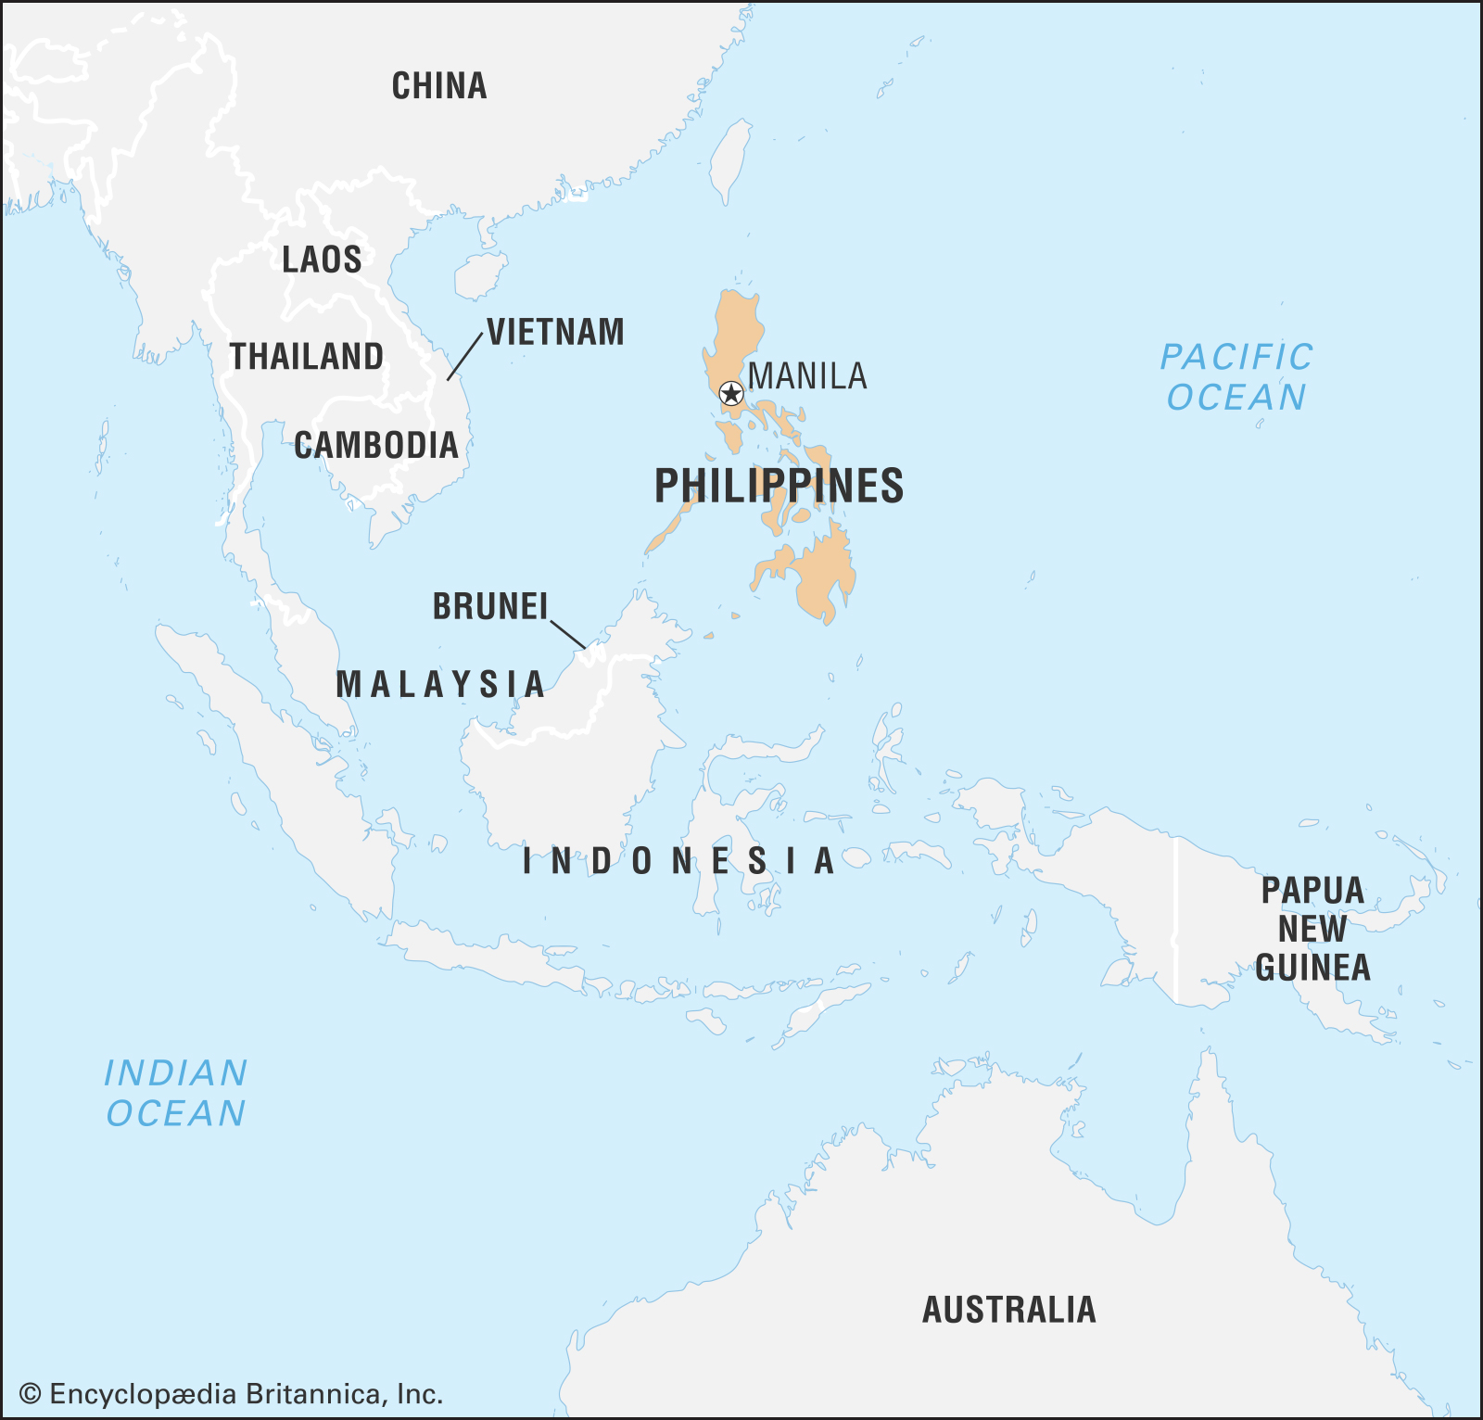
Grief and the Headhunters’ Rage
Renato Rosaldo: Chicano anthropologist and poet
The Chasers
Married to feminist anthropologist Michelle Rosaldo
Headhunting among Ilongot in Philippines
Why?
Force of emotion
Grieving his wife, Michelle, led to insight/understanding

Slide 9
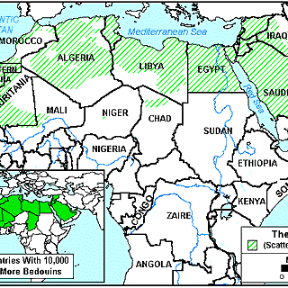
Writing Against Culture
Lila Abu-Lughod
“Wholes and halfies”
Palestinian-American
Self/other
Western/non-Western
Ethnography of the particular
Do Muslim Women Really Need Saving?
“Culture” as property of the “other”
Discourse and practice
Connections
Ethnography of the particular
Thebedouin.org

Slide 10
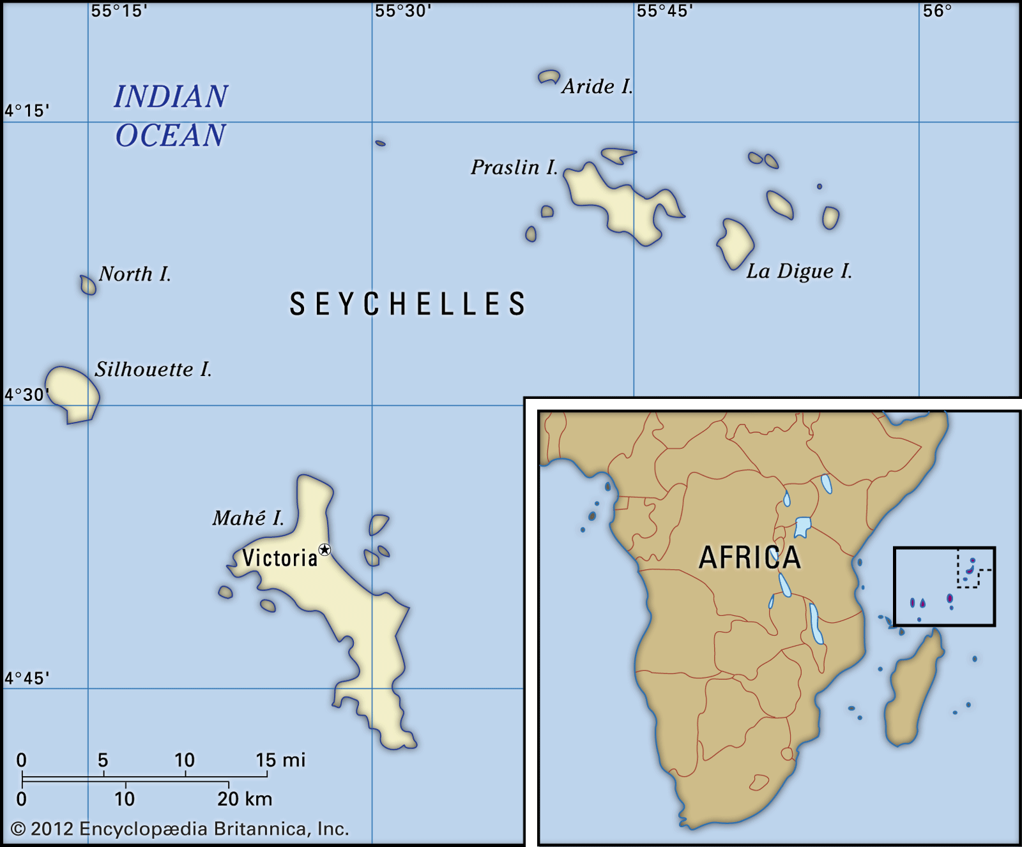
Stories from the Indian Ocean Islands
Rosabelle Boswell
Heritage and preservation
Post-slavery
Poet
Juxtaposition of stories “in the raw” with sensory interpretation
What does it feel like?

Slide 11
Key Takeaways
Personal experiences enrich, rather than diminish, ethnographic understanding
Certain knowledges only attainable through embodied experiences
No objective position, interpretation is key
No wider representativeness, not super generalizable

