Slide 1
Colonialism and Anthropological “Others”
Section 6

Slide 2
Big Idea
Anthropology emerged as a discipline in centers of imperial power and, intentionally or not, aided in colonial governance across the Western Hemisphere, Asia, and Africa. In particular, theories of scientific racism developed by early ethnologists were deployed as ideological justification for violent campaigns of dispossession and subjugation. And even anti-racist anthropologists associated with Boas tended to characterize Indigenous people as disappearing cultural remnants rather than as modern agents of resistance and survival. The theorists in this section demand that anthropology acknowledge and reckon with this colonialist legacy.

Slide 3
Learning Objectives
Describe the disputed relationship of anthropology and colonial systems
Critically analyze this legacy in anthropological research
Articulate critical theories that challenge the position of colonized people in anthropological projects

Slide 4
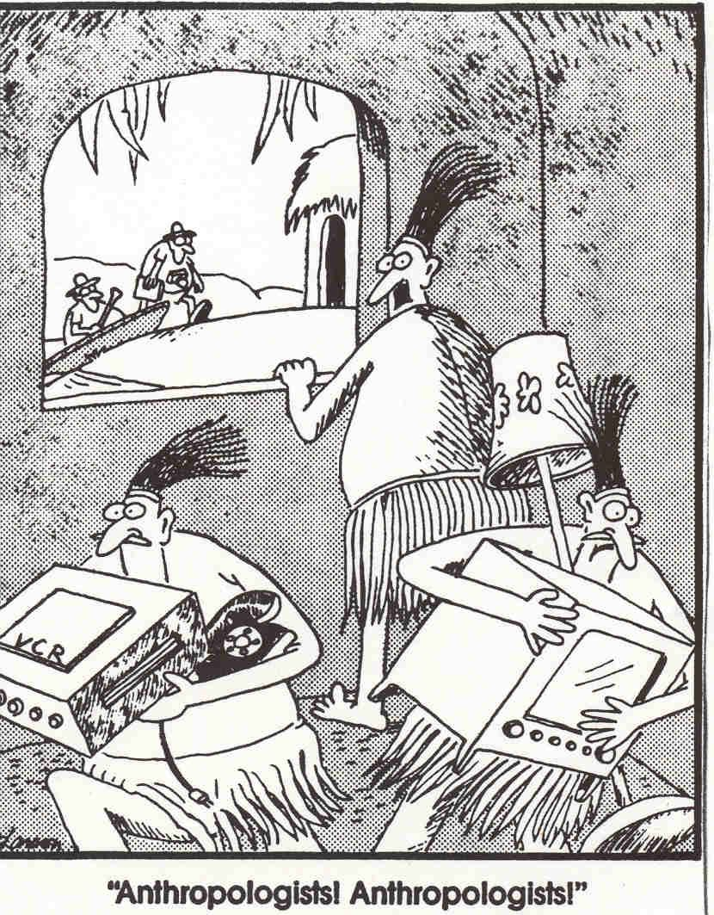
The Context
Here come the anthros

Slide 5
Colonialism and Anthropological “Others”
The Essays

Slide 6
Orientalism - Said
Palestinian American
Postcolonial studies
Orientalism: a “cultural” understanding of “the Orient” cultivated by British imperialism
Knowledge as central to power

Slide 7
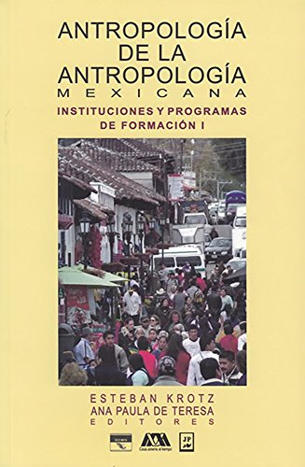
Anthropology of the South - Krotz
Mexican anthropologist
Indigenous language
Anthropology from the South
What makes it meaningfully different?

Slide 8
Applied Anthropology - Medicine
Lakota anthropologist
Linguistic discrimination
Civil rights activist
Native anthropologist
Applied anthropology

Slide 9
Savage Slot - Trouillot
Haitian anthropologist
Political activist
Power, statehood, globalization
Caribbean
The Savage Slot

Slide 10
Sea of Islands - Hau’ofa
Tongan and Fijian
Anthropologist and novelist
Oceania Center for Arts
A Sea of Islands

Slide 11
Key Takeaways
Distinction between Western researcher and non-Western (that is, colonized) research subject untenable
Anthropology tended to reproduce hegemonic (colonialist) knowledge
Anti-colonialist ways of knowing and acting

