Slide 1
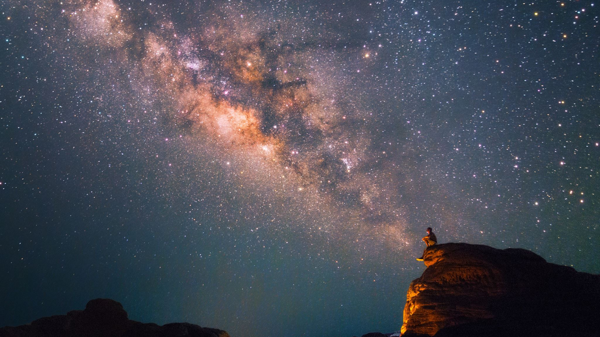
Queer Theory
Section 8

Slide 2
Big Idea
While theories of gender had delinked biological sex from gender expression, the advent of queer theory troubled categories related to sex, gender, identity, and desire altogether. In this section, we explore queer theoretical explorations of power and sexuality, transgender classifications, and racialized sexual identities.

Slide 3
Learning Objectives
Trace important developments in queer anthropology
Explain concepts such as sexuality and transgender from an anthropological lens
Demonstrate familiarity with various expressions of gender and sexual diversity

Slide 4
The Social Context

Slide 5
The Essays

Slide 6
Queer Anthropological Theory
Key Ideas
Beyond binaries (and categories)
Controlling sexual behaviors <-> state power
Desire just desire
Desire not same as identity

Slide 7
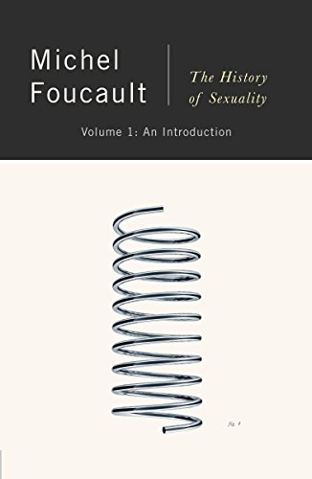
Michel Foucault
French poststructuralist
History of knowledge
Knowledge <-> power
Panopticon
Clinical gaze
Biopolitics
Sexual repression
The History of Sexuality

Slide 8
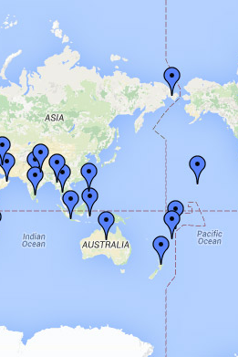
Morgan and Towle
Romancing the Transgender Native
“Third” gender?
Exoticizing
Lumps together divergent people
e.g. LGBTQIA+
Retains categories

Slide 9
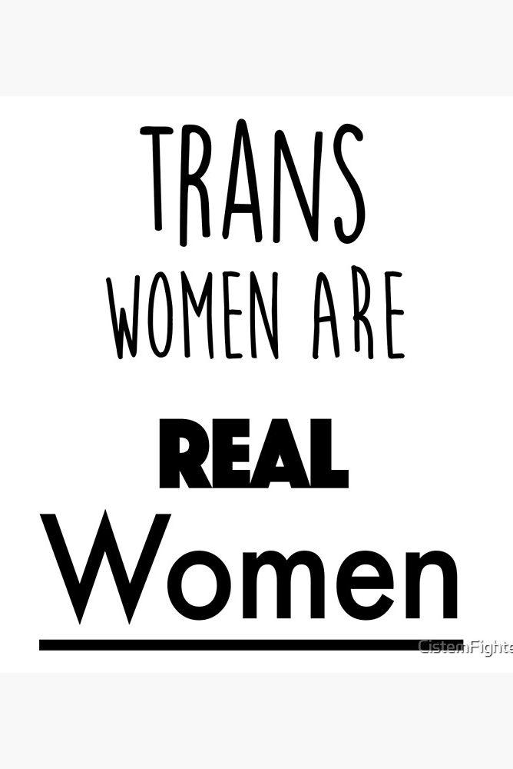
Susan Stryker
Transgender Feminism
Classic feminism predicated on womanhood/women’s experiences
But what is a woman?
Anatomy?
Identity?
Experiences?
“Transgender” as boundary queering and transgression
(what about transracialism?)

Slide 10
Jafari Allen
Erotic Subjectivity in Cuba
“Color drag”
Eroticized racial performance
Man -> woman
Dark -> light skinned, mulata

Slide 11
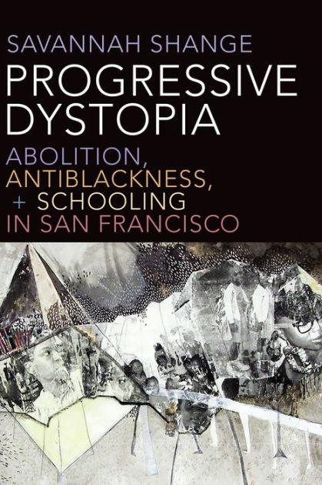
Savannah Shange
Play Aunties and Dyke Bitches
Gender performance and power
Stud-femme range
Gendered and racialized criminalization
School to prison pipeline
“Fictive” kinship in queer Black spaces

Slide 12
Key Takeaways
All of our ideas about sex, gender, kinship, and identity are socially constructed. All of them. Our notions of biology are cultural.

